Slide 1
UNIT - 2

Slide 2
Financial Regulatory Authorities
Regulators of Indian Financial System:
The Reserve Bank of India (RBI)- Organization, Objectives, Functions And Monetary Policy
Securities And Exchange Board of India (SEBI)- Organization, Objectives & Functions
Insurance Regulatory And Development Authority Of India (IRDAI)- Organization, Objectives & Functions
Pension Fund Regulatory Authority of India (PFRDA)- Organization, Objectives & Functions
UNIT OBJECTIVES:
To understand about Indian regulatory authorities.

Slide 3
INTRODUCTION:
Regulatory and Promotional Institutions: Financial institutions, financial markets, financial instruments and financial services are all regulated by regulators like Ministry of Finance, the Company Law Board, RBI, SEBI, IRDA, Dept. of Economic Affairs, Department of Company Affairs etc. The two major Regulatory and Promotional Institutions in India are Reserve Bank of India (RBI) and Securities Exchange Board of India (SEBI). Both RBI and SEBI administer, legislate, supervise, monitor, control and discipline the entire financial system. RBI is the apex of all financial institutions in India. All financial institutions are under the control of RBI. The financial markets are under the control of SEBI. Both RBI and SEBI have laid down several policies, procedures and guidelines. These policies, procedures and guidelines are changed from time to time so as to set the financial system in India.
Banking Institutions: Banking institutions mobilize the savings of the people. They provide a mechanism for the smooth exchange of goods and services. They extend credit while lending money. They not only supply credit but also create credit. There are three basic categories of banking institutions. They are commercial banks, co-operative banks and developmental banks.
Non-banking Institutions: The non-banking financial institutions also mobilize financial resources directly or indirectly from the people. They lend the financial resources mobilized. They lend funds but do not create credit. Companies like LIC, GIC, UTI, Development Financial Institutions, Organization of Pension and Provident Funds etc. fall in this category. Non-banking financial institutions can be categorized as investment companies, housing companies, leasing companies, hire purchase companies, specialized financial institutions (EXIM Bank etc.) investment institutions, state level institutions etc. Financial institutions are financial intermediaries. They intermediate between savers and investors. They lend money. They also mobilize savings.
There are many financial institutions in India and we have many regulators for regulating them in order to assure the proper functioning of the financial system in our nation.

Slide 4
Reserve Bank of India (RBI)
It is one of the financial regulators in India and it regulates everything related to money. It is also known as the Central Bank of India as well as the lender of last resort because of the impeccable function that it performs. It was established on April 1, 1935 in accordance with the provisions of the Reserve Bank of India Act, 1934. It regulates all the commercial banks in India like public sector banks, private sector banks, RRBs, Cooperative banks and all type of non-banking financial companies. It forms monetary policy and control the Inflation in the country with the help of monetary policy.
The Reserve Bank of India (RBI) is India’s central bank, also known as the banker’s bank. The RBI controls monetary and other banking policies of the Indian government. The Reserve Bank is permanently situated in Mumbai since 1937.
Legal frame work:
The Reserve Bank of India comes under the purview of the following Acts:
Reserve Bank of India Act, 1934
Public Debt Act, 1944
Government Securities Regulations, 2007
Banking Regulation Act, 1949
Foreign Exchange Management Act, 1999
Securitization and Reconstruction of Financial Assets and Enforcement of Security Interest Act, 2002
Credit Information Companies(Regulation) Act, 2005
Payment and Settlement Systems Act, 2007
Establishment of Reserve Bank of India
The Reserve Bank is fully owned and operated by the Government of India.
The Preamble of the Reserve Bank of India describes the basic functions of the Reserve Bank as:
Regulating the issue of Banknotes
Securing monetary stability in India
Modernizing the monetary policy framework to meet economic challenges

Slide 5
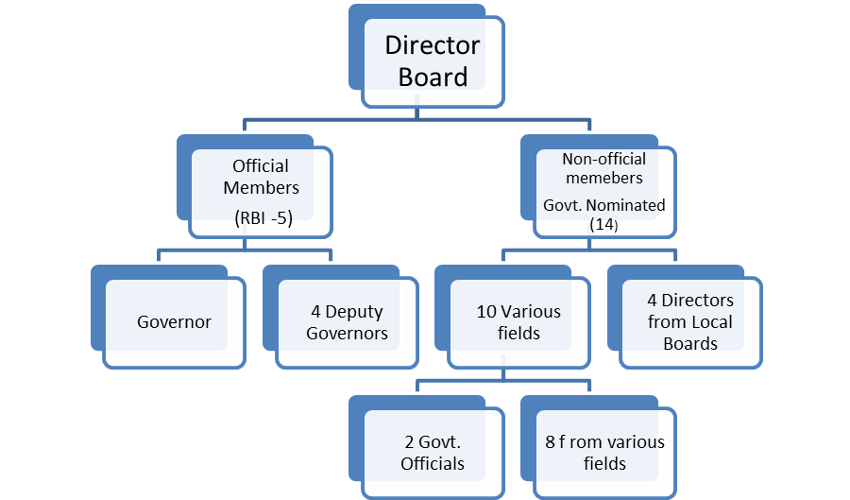
The overall direction of RBI lies with the 21 member central board of directors, composite of the governor, 4 deputy governor, 2 finance ministry representatives(usually the economic affair secretory and the financial service secretory ) , 10 government nominated directors , and 4 directors who represent local boards for Mumbai, Kolkata Chennai and Delhi.
Organization Structure of RBI

Slide 6

Objectives:
The primary objectives of RBI are to supervise and undertake initiatives for the financial sector consisting of commercial banks, financial institutions and non-banking financial companies (NBFCs).
Some key initiatives are:
Restructuring bank inspections
Fortifying the role of statutory auditors in the banking system

Slide 7
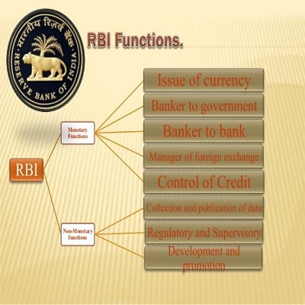
Role & Functions of Reserve Bank

Slide 8
1. Issue of Notes —The Reserve Bank has a monopoly for printing the currency notes in the country. It has the sole right to issue currency notes of various denominations except one rupee note (which is issued by the Ministry of Finance).
The Reserve Bank has adopted the Minimum Reserve System for issuing/printing the currency notes. Since 1957, it maintains gold and foreign exchange reserves of Rs. 200 Cr. of which at least Rs. 115 cr. should be in gold and remaining in the foreign currencies.
2. Banker to the Government–The second important function of the Reserve Bank is to act as the Banker, Agent and Adviser to the Government of India and states. It performs all the banking functions of the State and Central Government and it also tenders useful advice to the government on matters related to economic and monetary policy. It also manages the public debt of the government.
3. Banker’s Bank:- The Reserve Bank performs the same functions for the other commercial banks as the other banks ordinarily perform for their customers. RBI lends money to all the commercial banks of the country.
4. Controller of the Credit:- The RBI undertakes the responsibility of controlling credit created by commercial banks. RBI uses two methods to control the extra flow of money in the economy. These methods are quantitative and qualitative techniques to control and regulate the credit flow in the country. When RBI observes that the economy has sufficient money supply and it may cause an inflationary situation in the country then it squeezes the money supply through its tight monetary policy and vice versa.
5. Custodian of Foreign Reserves:-For the purpose of keeping the foreign exchange rates stable, the Reserve Bank buys and sells foreign currencies and also protects the country's foreign exchange funds. RBI sells the foreign currency in the foreign exchange market when its supply decreases in the economy and vice-versa. Currently, India has a Foreign Exchange Reserve of around US$ 487 bn.
6. Other Functions:-The Reserve Bank performs a number of other developmental works. These works include the function of clearinghouse arranging credit for agriculture (which has been transferred to NABARD) collecting and publishing the economic data, buying and selling of Government securities (gilt edge, treasury bills etc.)and trade bills, giving loans to the Government buying and selling of valuable commodities etc. It also acts as the representative of the Government in the International Monetary Fund (I.M.F.) and represents the membership of India.

Slide 9
RBI MONETARY POLICY
Monetary policy refers to the credit control measures adopted by the central bank of a country. In case of Indian economy, RBI is the sole monetary authority which decides the supply of money in the economy.
The Reserve Bank of India (RBI) is vested with the responsibility of conducting monetary policy. This responsibility is explicitly mandated under the Reserve Bank of India Act, 1934.
The Chakravarty committee has emphasized that price stability, growth, equity, social justice, promoting and nurturing the new monetary and financial institutions have been important objectives of the monetary policy in India.
DEFINITION OF MONETARY POLICY
R.P. Kent defines monetary policy as, “the management of the expansion and contraction of the volume of money in circulation for the explicit purpose of attaining a specific objective such as full employment.”
According to A. J. Shapiro, “Monetary Policy is the exercise of the central bank’s control over the money supply as an instrument for achieving the objectives of economic policy.”
In the words of D.C. Rowan, “The monetary policy is defined as discretionary action undertaken by the authorities designed to influence (a) the supply of money, (b) cost of money or rate of interest and (c) the availability of money.”
INSTRUMENTS OF MONETARY POLICY
Repo Rate
Reverse Repo Rate
Liquidity Adjustment Facility (LAF)
Marginal Standing Facility (MSF)
Bank Rate
Cash Reserve Ratio
Statutory Liquidity Ratio(SLR)
Open Market Operations
Market Stabilization Scheme (MSS)

Slide 10
Repo rate – It is the interest rate at which RBI gives loans to commercial banks.
Reverse Repo Rate – The interest rate at which RBI borrows from commercial banks is called the reverse repo rate.
Liquidity adjustment facility (LAF): It is a tool used in monetary policy, primarily by the Reserve Bank of India (RBI) that allows banks to borrow money through repurchase agreements (repos) or to make loans to the RBI through reverse repo agreements.
Marginal standing facility (MSF): It is a window for banks to borrow from the Reserve Bank of India in an emergency when inter-bank liquidity dries up completely.
Bank Rate – It is the interest rate at which RBI gives loans to the banks.
Cash Reserve Ratio – It refers to the minimum funds that banks have to keep with the RBI.
Statutory Liquidity Ratio- It is the fraction of the net time and demand liabilities of the banks in the form of liquid assets that banks have to maintain.
Open market operations (OMOs): The purchase and sale of securities in the open market by a central bank--are a key tool used by the Federal Reserve in the implementation of monetary policy.
Market Stabilization Scheme (MSS): These securities are issued with the objective of providing the RBI with a stock of securities with which it can intervene in the market for managing liquidity. These securities are issued not to meet the government's expenditure.

Slide 11
SEBI
Introduction:
SEBI is a statutory regulatory body established on the 12th of April, 1992. It monitors and regulates the Indian capital and securities market while ensuring to protect the interests of the investors formulating regulations and guidelines to be adhered to. The head office of SEBI is in Bandra Kurla Complex, Mumbai.
It was initially established as a non-statutory body, i.e. it had no control over anything but later in 1992, it was declared an autonomous body with statutory powers. This regulatory authority plays an important role in regulating the securities market of India. Thereby it is important to know the purpose and objective of the same.
Why was SEBI formed?
At the end of the 1970s and during the 1980s, capital markets were emerging as the new sensation among the individuals of India. Many malpractices started taking place such as unofficial self-styled merchant bankers, unofficial private placements, rigging of prices, non-adherence of provisions of the Companies Act, violation of rules and regulations of stock exchanges, delay in delivery of shares, price rigging, etc.
Due to these malpractices, people started losing confidence in the stock market. The government felt a sudden need to set up an authority to regulate the working and reduce these malpractices. As a result, the Government came up with the establishment of SEBI.
Organizational Structure of SEBI
SEBI has a corporate framework comprising various departments each managed by a department head. There are about 20+ departments under SEBI. Some of these departments are corporation finance, economic and policy analysis, debt and hybrid securities, enforcement, human resources, investment management, commodity derivatives market regulation, legal affairs, and more.
The SEBI Board consist of nine members-
One Chairman appointed by the Government of India
Two members who are officers from Union Finance Ministry
One member from Reserve Bank of India
Five members appointed by the Union Government of India

Slide 12
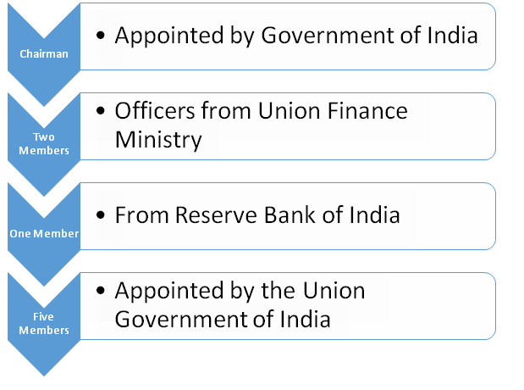
Objectives of SEBI:
The objectives of the Stock Exchange Board of India are:
1. Protection to the investors
The primary objective of SEBI is to protect the interest of people in the stock market and provide a healthy environment for them.
2. Prevention of malpractices
This was the reason why SEBI was formed. Among the main objectives, preventing malpractices is one of them.
3. Fair and proper functioning
SEBI is responsible for the orderly functioning of the capital markets and keeps a close check over the activities of the financial intermediaries such as brokers, sub-brokers, etc.

Slide 13
Role of SEBI:
This regulatory authority acts as a watchdog for all the capital market participants and its main purpose is to provide such an environment for the financial market enthusiasts that facilitate the efficient and smooth working of the securities market. SEBI also plays an important role in the economy
To make this happen, it ensures that the three main participants of the financial market are taken care of, i.e. issuers of securities, investors, and financial intermediaries.
1. Issuers of securities
These are entities in the corporate field that raise funds from various sources in the market. This organization makes sure that they get a healthy and transparent environment for their needs.
2. Investor
Investors are the ones who keep the markets active. This regulatory authority is responsible for maintaining an environment that is free from malpractices to restore the confidence of the general public who invest their hard-earned money in the markets.
3. Financial Intermediaries
These are the people who act as middlemen between the issuers and investors. They make the financial transactions smooth and safe.
Functions of SEBI:
The main primary three functions are-
Protective Function
Regulatory Function
Development Function

Slide 14
1. Protective Functions
As the name suggests, these functions are performed by SEBI to protect the interest of investors and other financial participants.
It includes-
Checking price rigging
Prevent insider trading
Promote fair practices
Create awareness among investors
Prohibit fraudulent and unfair trade practices
2. Regulatory Functions
These functions are basically performed to keep a check on the functioning of the business in the financial markets.
These functions include-
Designing guidelines and code of conduct for the proper functioning of financial intermediaries and corporate.
Regulation of takeover of companies
Conducting inquiries and audit of exchanges
Registration of brokers, sub-brokers, merchant bankers etc.
Levying of fees
Performing and exercising powers
Register and regulate credit rating agency
3. Development Functions
This regulatory authority performs certain development functions also that include but they are not limited to-
Imparting training to intermediaries
Promotion of fair trading and reduction of malpractices
Carry out research work
Encouraging self-regulating organizations
Buy-sell mutual funds directly from AMC through a broker

Slide 15
Powers of SEBI:
When it comes to stock exchanges, SEBI has the power to regulate and approve any laws related to functions in the stock exchanges.
It has the powers to access the books of records and accounts for all the stock exchanges and it can arrange for periodical checks and returns into the workings of the stock exchanges.
It can also conduct hearings and pass judgments if there are any malpractices detected on the stock exchanges.
When it comes to the treatment of companies, it has the power to get companies listed and de-listed from any stock exchange in the country.
It has the power to completely regulate all aspects of insider trading and announce penalties and expulsions if a company is caught doing something unethical.
It can also make companies list their shares in more than one stock exchange if they see that it will be beneficial to investors.
Coming to investor protection, SEBI has the power to draft legal rules to ensure the protection of the general public.
It also has the power to regulate the registration of brokers and other middlemen who will deal with investors in the market.

Slide 16
Insurance Regulatory and Development Authority of India (IRDAI)
Introduction:
The Insurance Regulatory and Development Authority (IRDA) is a national agency of the Government of India which is a financial regulator of all private sector and public sector insurance companies in India. It regulates the functioning of insurance companies to direct them to work in the public interest. It was established by an act of IRDA Act 1999, which was amended in 2002 to incorporate some emerging requirements. The Head-Quarter is in Hyderabad.
IRDA - Insurance Regulatory Development and Authority is the statutory, independent and apex body that governs and supervise the Insurance Industry in India
It was constituted by Parliament of India Act called Insurance Regulatory and Development Authority of India (IRDA of India) after the formal declaration of Insurance Laws (Amendment) Ordinance 2014, by the President of India Pranab Mukherjee on December 26,2014.
ESTABLISHMENT OF IRDA:-
Until 2000, the insurance business was regulated by the Indian government. Following the suggestion of the Malhotra Committee report in 1999, The IRDA was founded in 2000 as a stand-alone apex body. The IRDA began accepting registration applications through invites in august 2000, allowing corporations from foreign nations to invest up to 26% in the market. Under
STRUCTURE OF IRDA:-
IRDA is a ten-member body consists of
One Chairman (For 5 Years & Maximum Age - 60 years)
Five whole-time Members (For 5 Years and Maximum Age- 62 years)
Four part-time Members (Not more than 5 years)
The present Chairman of IRDAI is Subhash Chandra Khuntia.
The chaiman and IRDA members appointed by central government of india

Slide 17
FUNCTIONS AND ROLE OF IRDA:- There are various functions and role of IRDA which are as following:-
Issuing, renewing, modifying, withdrawing, suspending or cancelling registration.
Protecting policyholder interest.
Specifying qualifications, code of conduct, training for intermediaries and agents.
Specifying the code of conduct for surveyors and loss asserters.
Promoting efficiency in the conduct of Insurance business.
Promoting and regulating professional organization connected with the insurance and re-insurance industry.
Levying fees and other charges
Regulating a margin of solvency
Inspecting and investigating insurers, intermediaries and others relevant organization.
Regulates rates, terms and conditions
Specifying how account books should be kept.
Regulating companies’ investment and funds.
Adjudicate disputed between insurers and intermediaries.
Supervising the tariff advisory committee.
Promote professional organization
Maintain books of accounting and auditing.
OBJECTIVES OF IRDA:-
The objective of IRDA of India is to enforce the provisions comes under the Insurance act. The statement of the IRDA is:-
To safeguard the policyholder’s interest and ensure that they are treated fairly.
To ensure the financial soundness of the insurance business by regulating it fairly.
Regularly establish regulations to guarantee that the industry works in a clear and unambiguous manner
FEATURES AND BENEFITS OF IRDA:-
Following are the salient features of the apex body, the insurance regulatory and development authority of India:-
Acts as an insurance sector regulator.
The policyholder’s interest are safeguarded.
The apex body establishes rules and regulations under section 144 A of the insurance Act of 1938.
The insurance act entrusts it with issuing certificates of registration to new insurance businesses seeking to operate in India.

Slide 18
TYPES OF INSURANCE REGULATED BY THE IRDA:-
Insurance is mainly divided into life and Non-life Insurance. These are further classified into other types of insurance. These are the types of insurance regulated by the IRDA:-
1.) Life insurance:
Terms plans
Endowment policies
Unit-linked insurance policies.
Retirement policies.
Money-back policies.
2.) General insurance:
Health insurance policies.
Vehicle motor insurance policy;
a. Car insurance
b. Bike insurance.
Property insurance policies
Travel insurance plans
Gadget insurance plans.
DIFFERENCE BETWEEN IRDA AND SEBI:-
1.) The IRDA regulates the insurance industry. On the other side SEBI regulates the securities and commodity industry. 2.) The IRDA established in 1999. On the other side SEBI established in 1992.
3.) The IRDA protects the interest of insurance policyholders, on the other side SEBI protects the interests of investor in securities.
4.) The IRDA grant certificate of registration to insurance companies to issue insurance policies, on the other side SEBI grant certificate of registration to stockbrokers, bankers, sub brokers, to issue deeds.
5.) The IRDA makes rules and regulations under the Insurance Regulatory and Development Authority Act, on the other side SEBI make rules and regulations under the Securities and Exchange Board of India Act.

Slide 19
PFRDA: PENSION FUND REGULATORY AND DEVELOPMENT AUTHORITY
Pension Fund Regulatory and Development Authority was instated in the year 2003. The body was set up with an aim to promote, regulate and develop the pension sector in the country. The National Pension Scheme (NPS) was launched by PFRDA in the year 2003 and thereby extended to all sections of citizens in the year 2009. Pension fund regulatory and development authority comes under the jurisdiction of the Ministry of Finance.
Functions of PFRDA
The preamble of PFRDA states that the aims of the authority is – “to promote old age income security by establishing, developing and regulating pension funds, to protect the interests of subscribers to schemes of pension funds and for matters connected therewith or incidental thereto.”
PFRDA is head-quartered at New Delhi with various regional offices spread across the country.
Promote pension scheme in the country by fostering mandatory as well as voluntary pension schemes in order to serve the old age income needs of retired personnel
National Pension System, both tier 1 and tier 2 are under the purview of PFRDA and are dictated by the same
PFRDA performs the function of appointing various intermediate agencies like Pension Fund Managers, Central Record Keeping Agency (CRA) etc.
Educating the general public and stakeholders about the importance of pension.
Training of intermediaries that perform the task of popularizing and educating people about the importance of pension.
Addressing grievances related to various pension schemes in the country.
Addressing and resolving disputes between various intermediaries like banks and between customers and intermediaries.
Pension Fund Managers (PFMs)
Listed below are some of the most important functions of the PFMs.
Pension Fund Manager essentially are mandated to invest and manage funds of subscribers enrolled in the National Pension System
Investment of contribution of subscriber as per rules and guidelines of the PFRDA
Maintain books and records of the investment and flow of funds
Construction of portfolio of customers who choose auto-allocation of funds
Reporting to PFRDA on a regular basis
Public disclosure of financial information from time to time as per guidelines issued by PFRDA

Slide 20
ONLINE SERVICES OFFERED BY PFRDA
Pension Fund Regulatory & Development Authority has taken several measures online as well as offline to facilitate the individuals willing to invest in Pension Schemes. There are numerous online services offered by the regulatory body which eventually encourages the consumers to seek different retirement funds
Opening Pension Fund account under NPS
Processing contributions to PRAN account (Excluding NPS- Swavalamban and Atal Pension Yojana accounts)
Activation of Tier-2 account
Modification of personal details of subscribers
Investment plan modification
Change of pension plans
Downloading and accessing transaction statements
Processing exit or withdrawal requests
Complaint filing
Printing e-PRAN and more

Slide 21
Presented By:
Prof. Dr. S. Rani & Prof. Vaishali Chauhan
(Malla Reddy University, Hyderabad)
Thank You…

